Slide 1
An Introduction to Computer Architecture
and
Why Should We Study It?

Slide 2
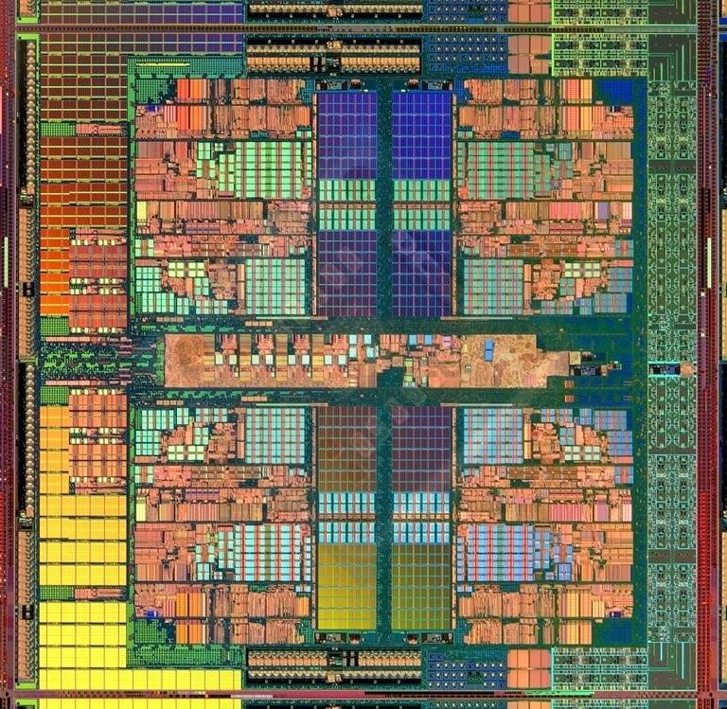
What is Computer Architecture?
Architecture
Computer Architecture
A House in Barcelona
AMD Barcelona
The science and art of designing, selecting, and interconnecting hardware components and designing the hardware/software interface to create a computing system that meets functional, performance, energy consumption, cost, and other specific goals.

Slide 3
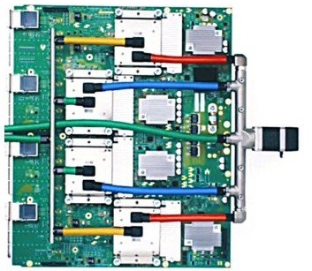
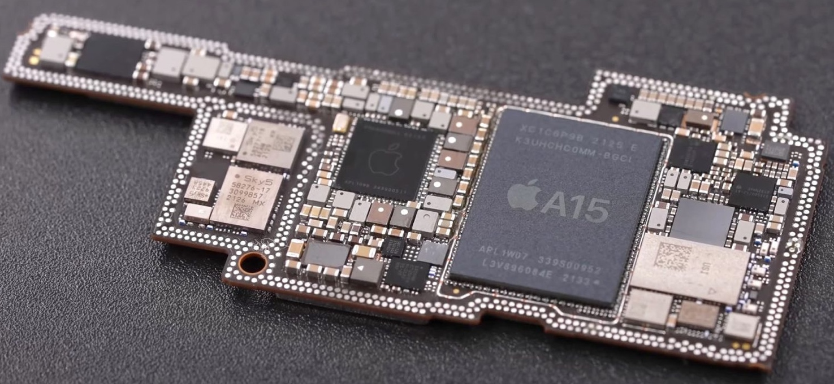
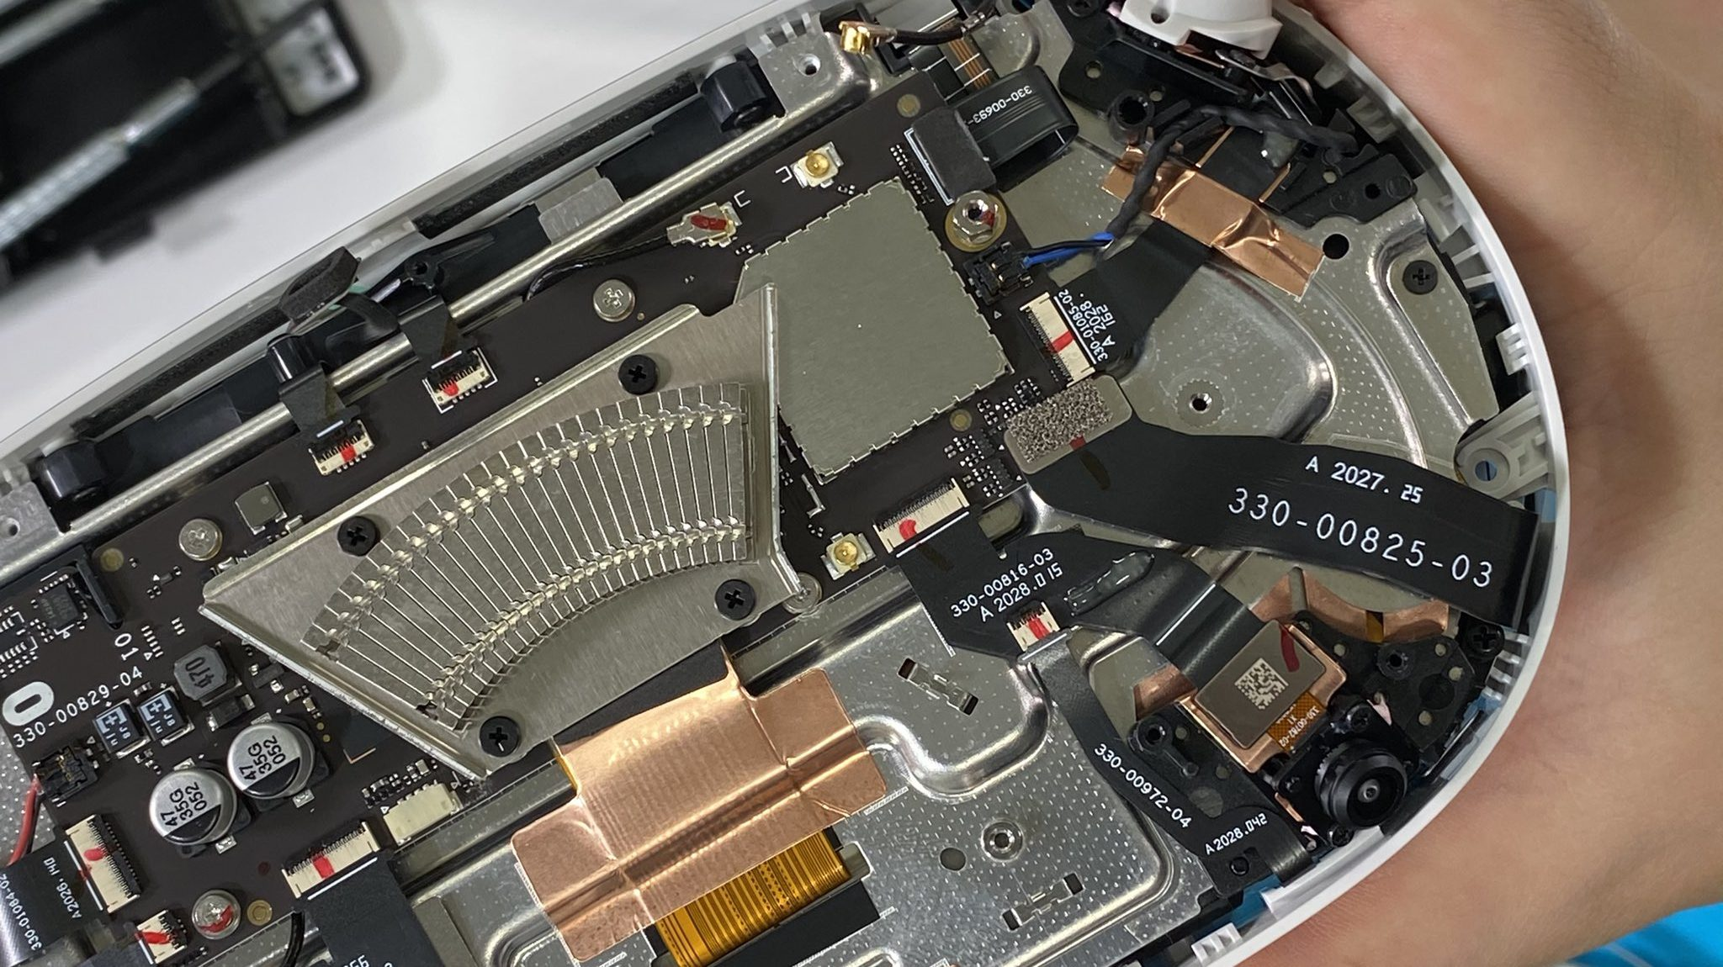
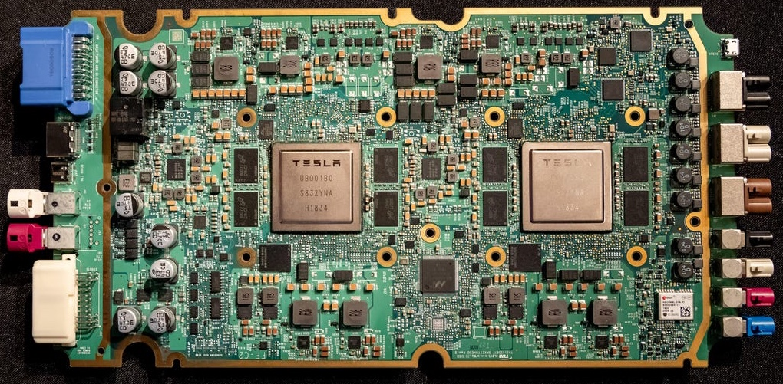
Where do you find computers today?
Apple - A15
Google – TPU v4
Oculus – Quest 2
Tesla – FSD Chip
Q: What has fueled progress in computer technology?

Slide 4
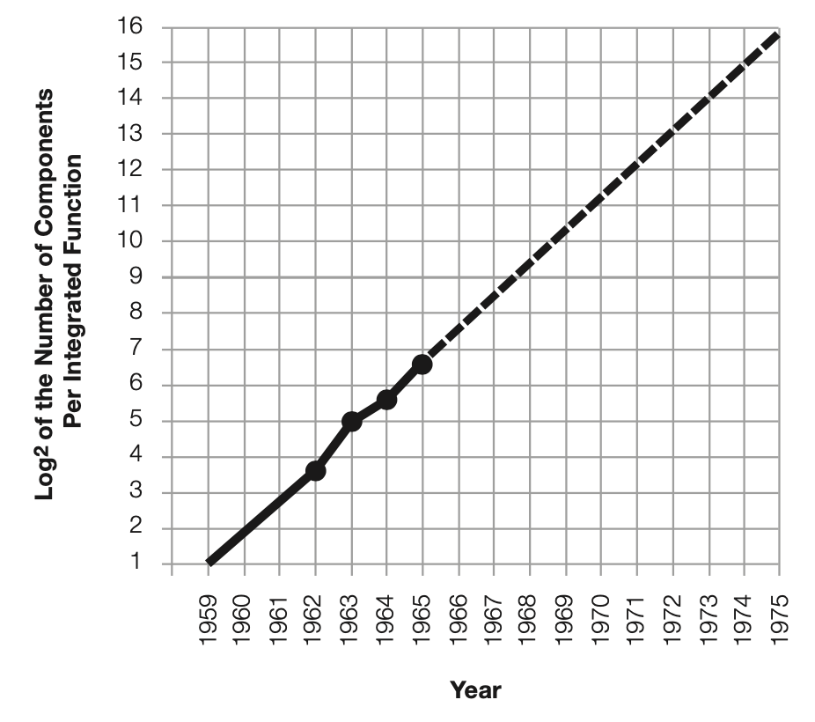
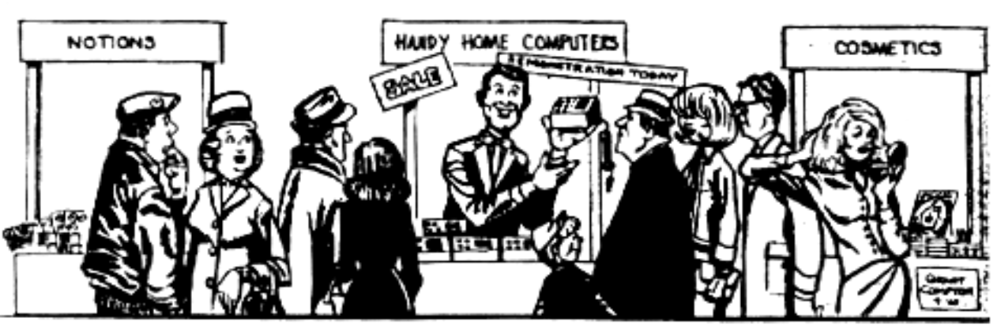
A Man Who Can See The Future
Gordon E. Moore, “Cramming more components onto integrated circuits,” Electronics Magazine, 1965.
With unit cost falling as the number of components per circuit rises, by 1975 economics may dictate squeezing as many as 65,000 components on a single silicon chip
Notes:
In 1965, he realized that in 20-25 years, we would have hand held computing devices!

Slide 5
Moore’s Law: The Number of Transistors
Transistor Revolution Begins
Intel 4004 (1971)
4 bits, 750 kHz
used in calculators
Intel 8086 (1976)
16 bits, 5 MHz
Notes:
Gordon E. Moore, “Cramming more components onto integrated circuits,” Electronics Magazine, 1965.

Slide 6
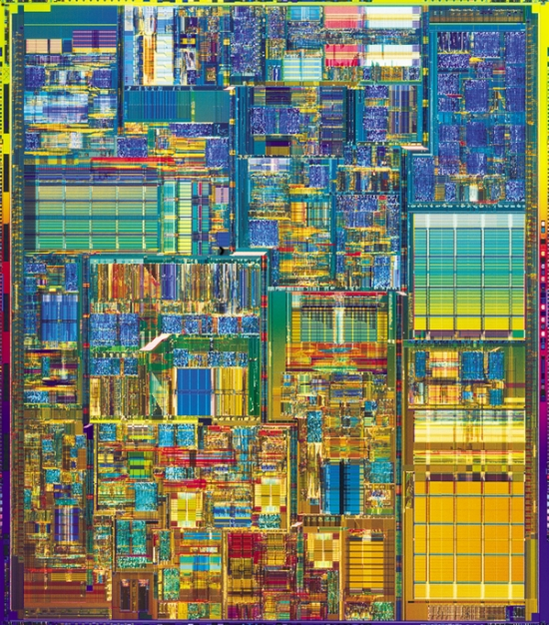
Revolution II: Implicit Parallelism
Pinnacle of Single-Core Microprocessors
Intel Pentium4 (2003)
Application: desktop/server
Technology: 90nm (1/100x)
55M transistors (20,000x)
101 mm² (10x)
3.4 GHz (10,000x)
1.2 Volts (1/10x)
32/64-bit data (16x)
22-stage pipelined datapath
3 instructions per cycle (superscalar)
Two levels of on-chip cache
data-parallel vector (SIMD) instructions, hyperthreading

Slide 7
The End of Moore’s Law? Physical Limits
Transistor Size over Time

Slide 8
Moore’s Law today
Apple
M1
Apple
A12
data c/o WikiChip
Notes:
gray line is Moore’s Law, doubling density every ~2.5 years
TSMC 7nm was used for Apple A12 processor, in iPhone XS/XR

Slide 9
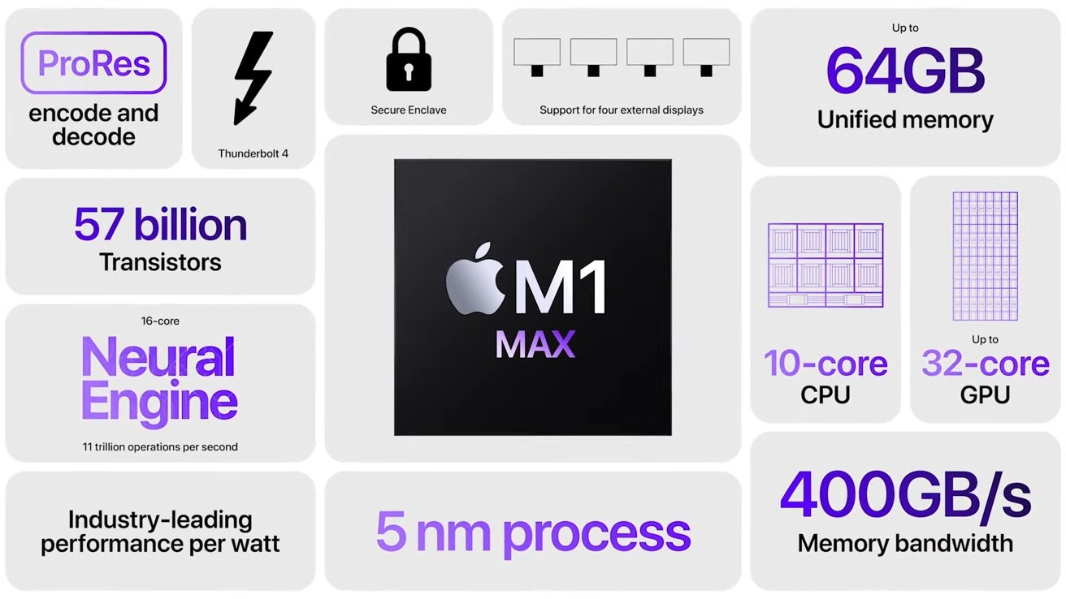
Apple M1 MAX

Slide 10
The End of Moore’s Law? Power Wall

